Slide 1
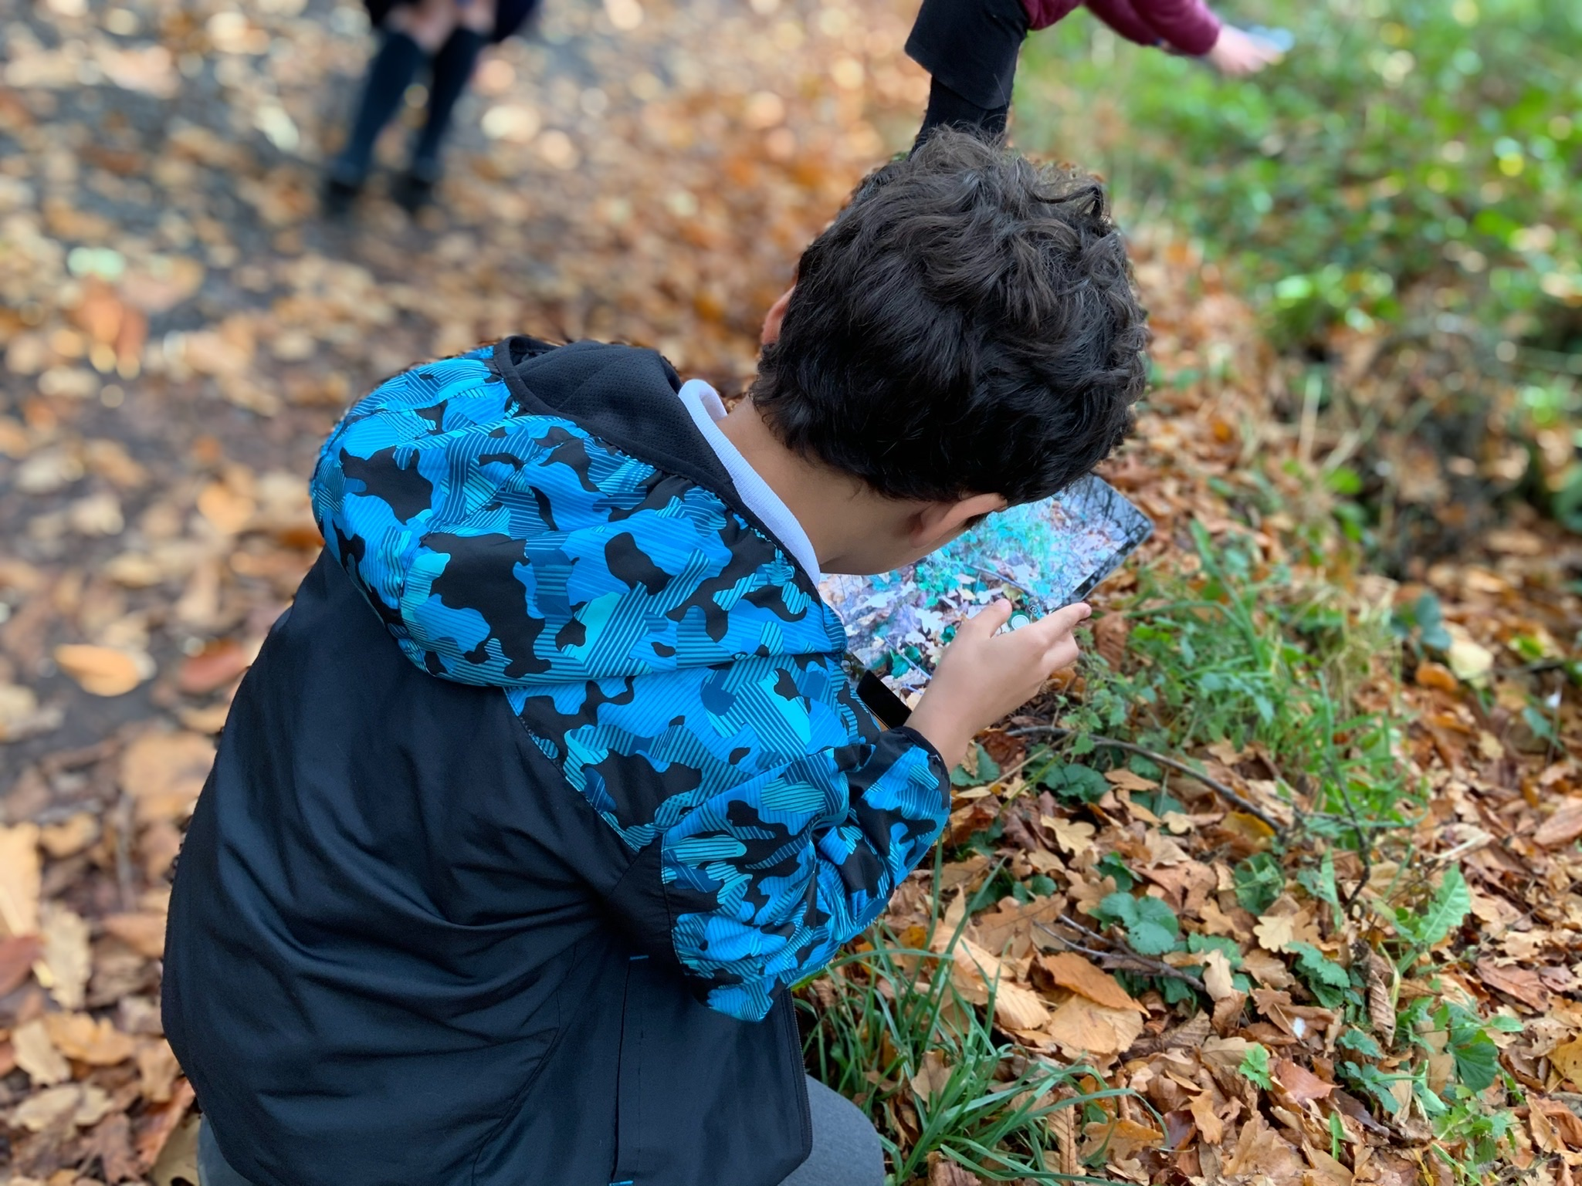
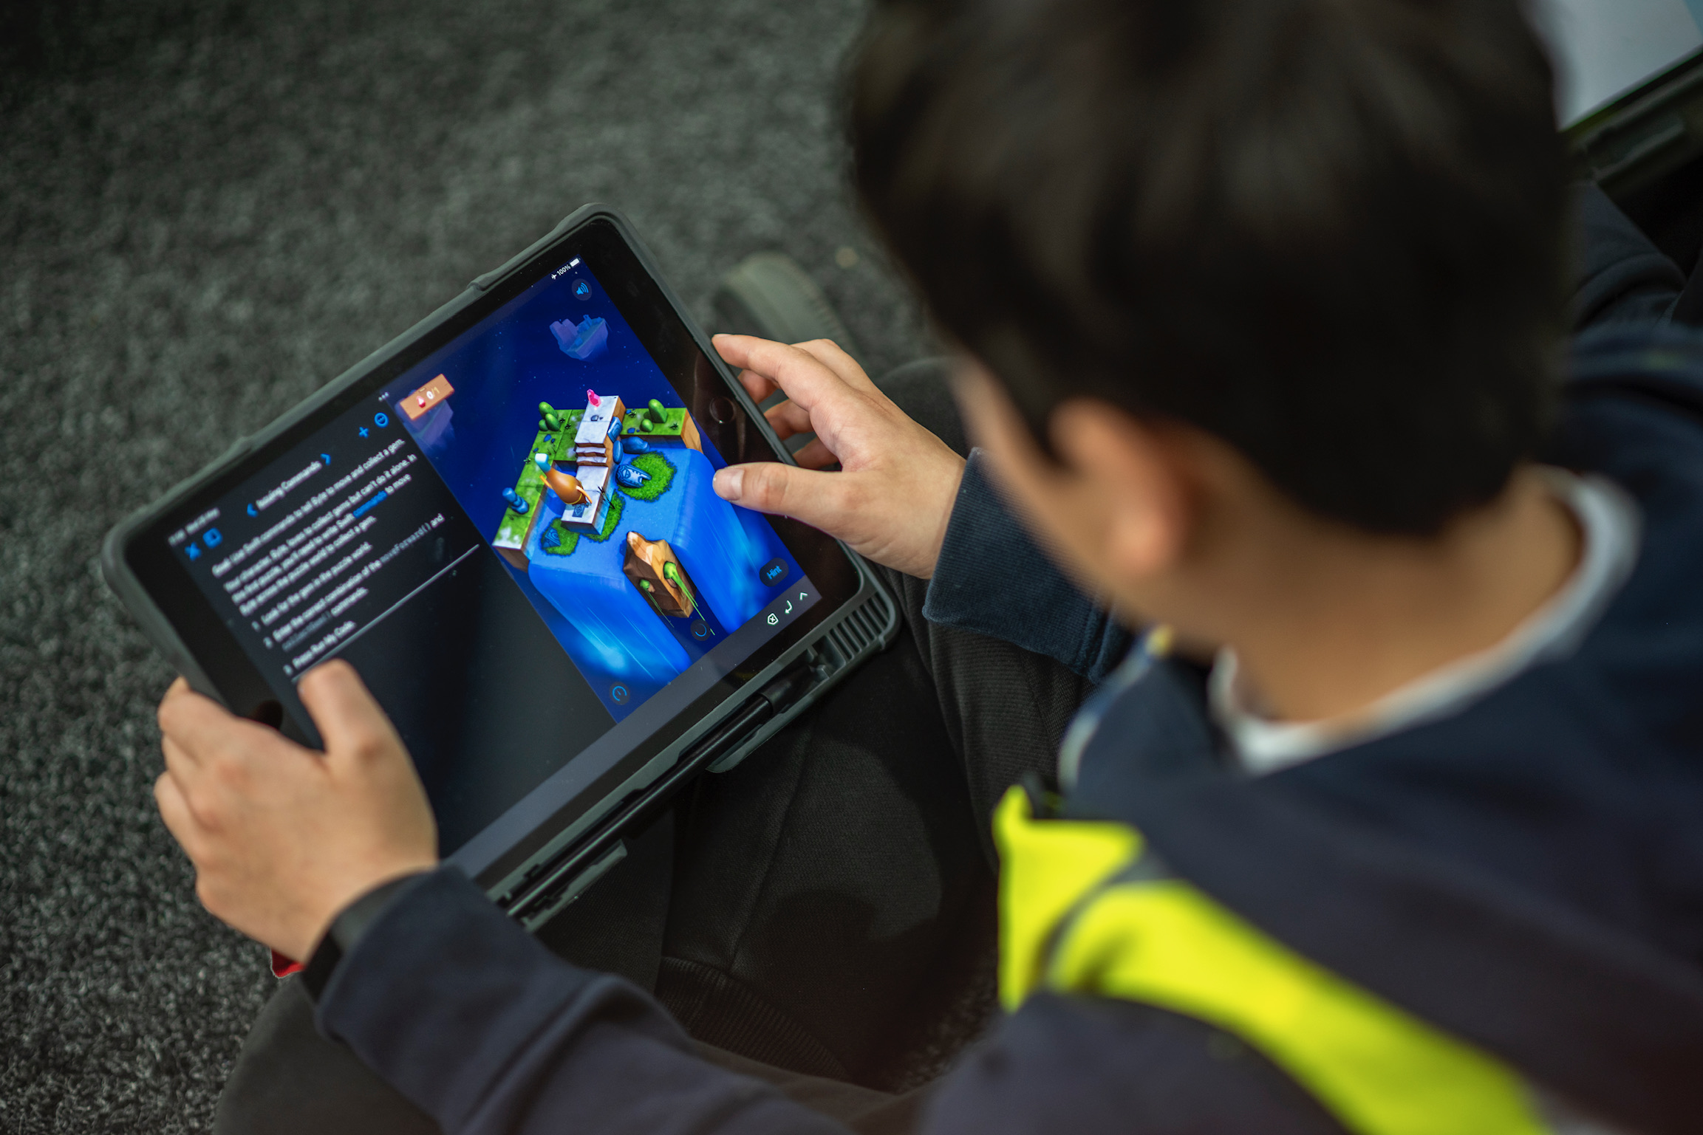
Screens and Social Media

Slide 2
Be Careful!
Don’t Conflate these
Screen - time
Persuasive design
Social Media
Content
Education
Notes:
Don’t conflate digital terms and screen time with all these. They are different and the evidence of impact is different.
Using digital technology has been shown to have positive impacts on education, fine motor skills, reactions, social emotional wellbeing, development… it’s how and what within tech

Slide 3
Screen Time
What does this mean?
What impact does the screen have?
Notes:
Screen time is the amount of time a person spends looking at a computer/tv screen.

Slide 4
What is Screen time?
Can cause eye fatigue and strain. Recommendation: 20-20-20
Blue light impacts sleep.
Recommendation: No screens 1 hr prior to sleep
Notes:
What it means is looking at a screen.
There is an unfounded fear that blue light causes eye damage. There’s 10 times the strength of blue light when you are outside compared to screens. Harvard Medical review.

Slide 5
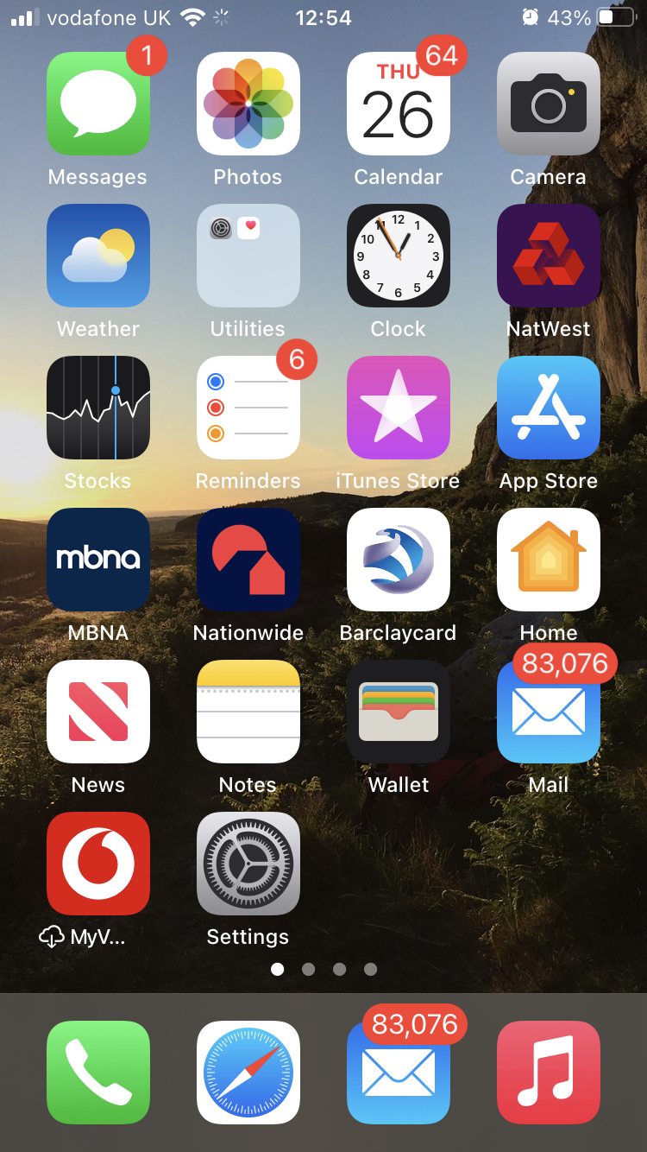
Persuasive Design
Notifications
Doom Scrolling
Likes/Comments
Gamer points
Loot boxes
Notes:
How do we deal with this?
Notifications - Red number that goes up and down.
Doom scrolling - designed to make you look for next dopamine hit. Something exciting just around the corner. Tick Toc has optimised this and the alogrithm shares the most reacted or longest watched vids.
Likes - Validation you are doing something right.
Gamer points, add ons, etc,.
Loot boxes - Online gambling
Education of how games/social media are designed to make you want to interact.
Not allowing young people to engage with these until legally allowed to
Instagram settings
Talk to your children.
Limits on access.
Limits on time
Inspires support

Slide 6
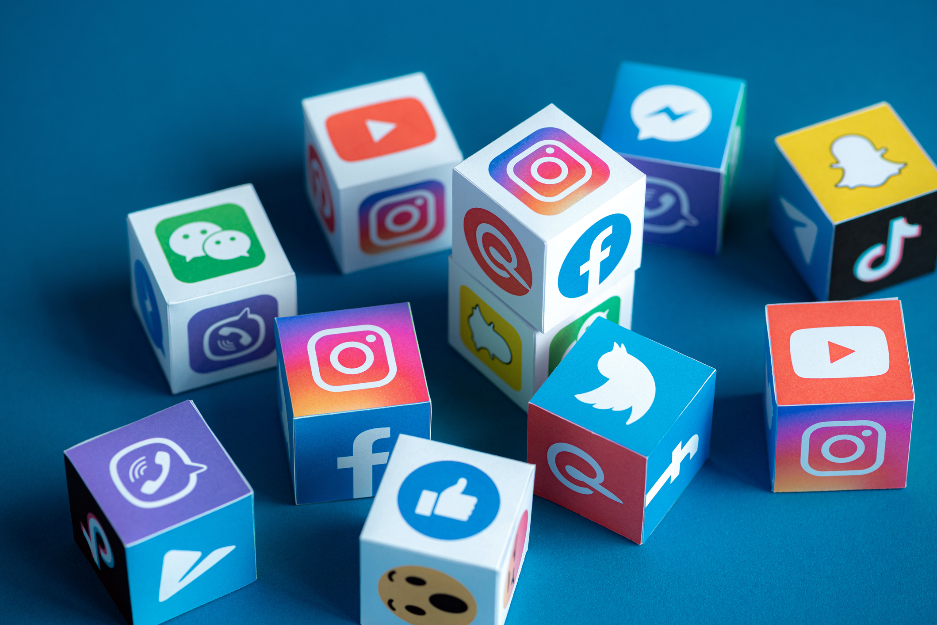
Social Media
What is it?
Risks
Settings
NSPCC resource
Notes:
Are you friends or do you have login details? - Did you set it up with them?
Mental health
Peer pressure
Anxiety
Bullying
Blocking
Limiting access
Not being negative
Speaking to children
Where are they accessing it when at home?
Time constraints
Police

Slide 7
Content
Content Filtering
Notes:
What sites are your young people accessing.
Do you have a shared google account?
Have you locked the history so it can be deleted.
Have you locked out private browsing.
Have you got parent controls activated on your home network to filter content on both phone and broad band
No 1 tool. Don’t let students access sites in a private space. Laptop in living room only. Not bedroom..

Slide 8
Education
Hatties effect size.
Notes:
What sites are your young people accessing.
Do you have a shared google account?
Have you locked the history so it can be deleted.
Have you locked out private browsing.
Have you got parent controls activated on your home network to filter content on both phone and broad band
No 1 tool. Don’t let students access sites in a private space. Laptop in living room only. Not bedroom..

Slide 9
What’s our behaviour.
Our mobile use effects young people
Our mobile use effects young people
Notes:
What sites are your young people accessing.
Do you have a shared google account?
Have you locked the history so it can be deleted.
Have you locked out private browsing.
Have you got parent controls activated on your home network to filter content on both phone and broad band
No 1 tool. Don’t let students access sites in a private space. Laptop in living room only. Not bedroom..

Slide 10
Takeaways
Notes:
Try to limit access using tools provided by SM/Internet Providers/Phone providers
Build a positive relationship with kids and their use of tools. Be involved.
Share google accounts on public machines to see.
Value what they interact with and talk to them about it.
Educate them about
NSPCC
Inspire will deal with iPad - No social media. No gaming. Can make a request to block.
We are also in process of applying JAMF parent
Screen time

